Slide 1

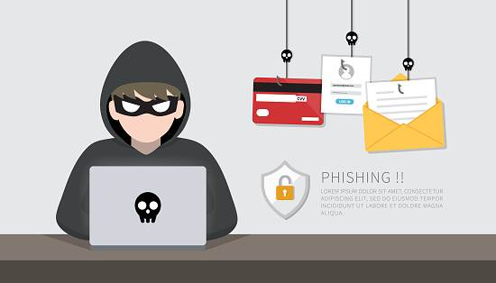
Phishing is a form of cyber attack where fraudsters impersonate a trusted entity to deceive victims into revealing sensitive information. They typically use email, text messages, or fake websites to trick users into providing personal details, financial information, or login credentials. This deceptive practice is a significant threat as it exploits human vulnerability rather than technological weaknesses, making it a challenging issue in cybersecurity.
This training will equip you with knowledge and skills to identify and avoid these scams, protecting your personal information and financial security.
phishing attacks.

Slide 2
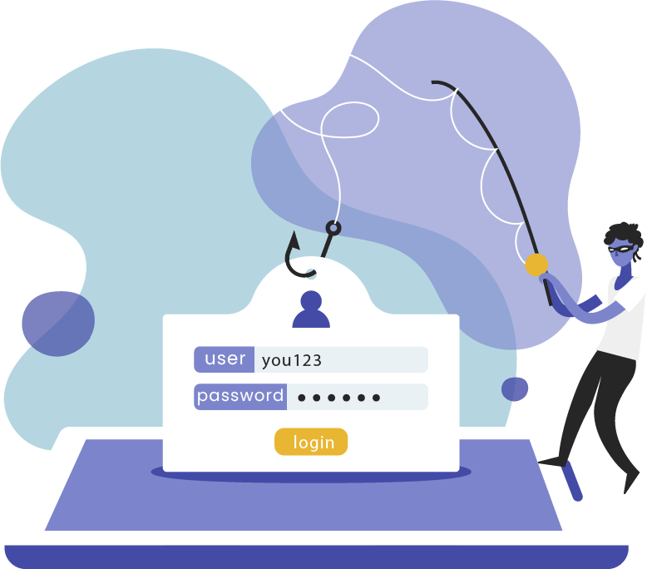
what is phishing attack ?
Phishing is a form of cyber attack where fraudsters impersonate a trusted entity to deceive victims into revealing sensitive information. They typically use email, text messages, or fake websites to trick users into providing personal details, financial information, or login credentials. This deceptive practice is a significant threat as it exploits human vulnerability rather than technological weaknesses, making it a challenging issue in cybersecurity.
This training will equip you with knowledge and skills to identify and avoid these scams, protecting your personal information and financial security.
Phishing is a cyber security threat where attackers impersonate trusted entities to trick victims into revealing sensitive information, often through emails or websites. These scams exploit human error and trust, bypassing technological defenses to reach their targets. The consequences of phishing can be severe, leading to identity theft, financial loss, and other forms of harm.

Slide 3
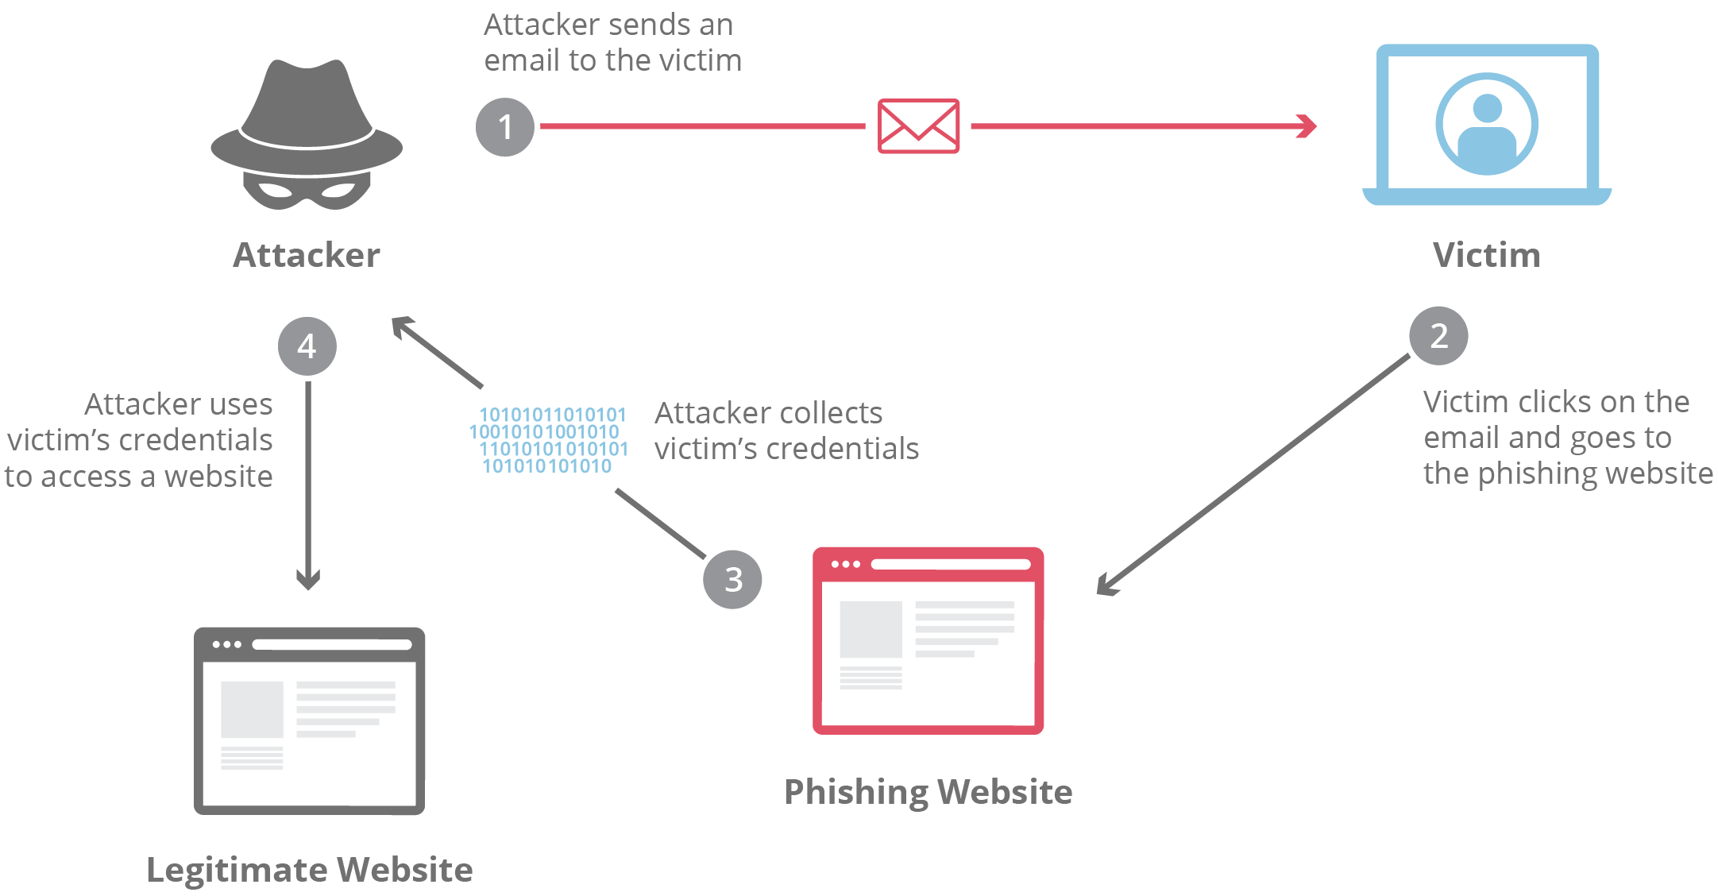
Target Identification: The attacker identifies the target, which could be an individual or an organization, and strategizes on the type of data they can use for the attack.
what is phishing attack ?
Phishing is a cyber security threat where attackers impersonate trusted entities to trick victims into revealing sensitive information, often through emails or websites. These scams exploit human error and trust, bypassing technological defenses to reach their targets. The consequences of phishing can be severe, leading to identity theft, financial loss, and other forms of harm.
Creating the Trap: The attacker creates fake emails or phony webpages that appear to be from a trustworthy source.
Launching the Attack: The attacker sends out the deceptive messages. These messages often contain a call to action, such as clicking on a link or downloading a file.
Data Collection: The attacker collects the data provided by the victims on the fake webpages.
Misuse of Information: The collected information is then used for malicious activities, such as unauthorized access to accounts, identity theft, or financial fraud

Slide 4
How phishing attack works ?
Target Identification: The attacker identifies the target, which could be an individual or an organization, and strategizes on the type of data they can use for the attack.
Creating the Trap: The attacker creates fake emails or phony webpages that appear to be from a trustworthy source.
Launching the Attack: The attacker sends out the deceptive messages. These messages often contain a call to action, such as clicking on a link or downloading a file.
Data Collection: The attacker collects the data provided by the victims on the fake webpages.
Misuse of Information: The collected information is then used for malicious activities, such as unauthorized access to accounts, identity theft, or financial fraud

Slide 5
Types of phishing attack
email and spam
email and spam
Spear phishing
Search engine
DNS based phishing
MITM phishing
Session hacking
Key loggers
email and spam
Trojaned host
Instant messaging
Clone phishing
Phone phishing

Slide 6
